Slide 1
Cycle Statistic Tool
Cody Klingler & Jacob Hoffman

Slide 2
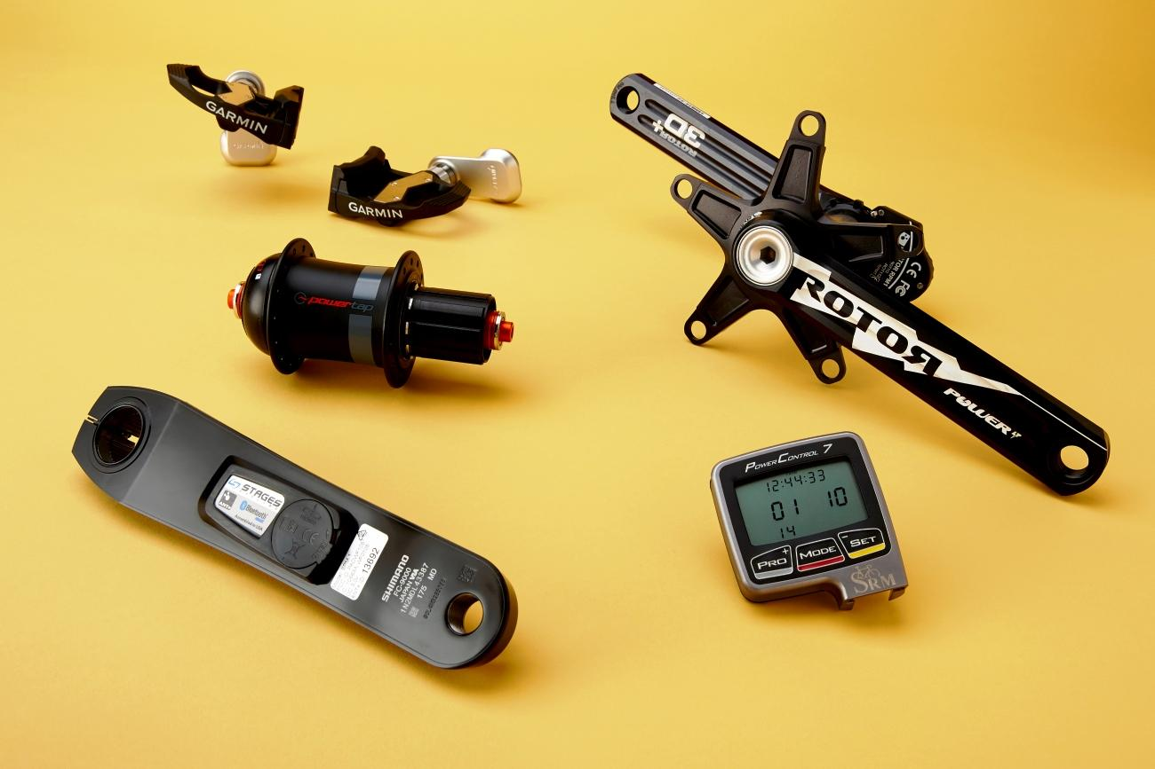
PROBLEM
Available bicycle meters offer very few measurements.
Smart devices do not offer accurate live measurements beyond speed and location.
Cyclists require a better, more encompassing solution for setting goals and tracking improvement.
Notes:
Currently, there are several wearable devices available for cyclists that offer general data collection about a cycling session; however, these do not offer specific statistic tracking for the
user, only general data about the location, duration, and exercise of the cycling trip. The specialized meters that are available to cyclists currently offer very few measurements. Cyclists require a better,
more encompassing solution for setting goals and tracking improvement.
-----
Bicycle meter are tools that allow you measure information about a bicycle as you ride it.
To cyclists, one of the most valuable statistics is power output. Current power meters are expensive ($400) and offer little beyond measuring power.
Smart devices are limited to general information about your cycling like location, speed, and heartbeat.

Slide 3
SOLUTION
Sensors and components may be used to create a device designed to provide a large collection of cycling data.
Attaching sensors and components directly to the bicycle allows for more specific cycling data to be measured.
Transmitting cycling data to a companion application will provide record of each cycling session for use in improving a user’s cycling skills.
Notes:
The Cycle Statistic Tool is a data recording device which will be attached to the frame of a bicycle. In this position, several electronic components may be used to record statistics about a user’s cycling trip. The Cycle Statistic Tool will transmit data to a companion application that is installed on a user’s smartphone. This application will utilize the collected information to provide records of a user’s cycling sessions in the form of graphs and charts that enable the user to improve their cycling skills.

Slide 4
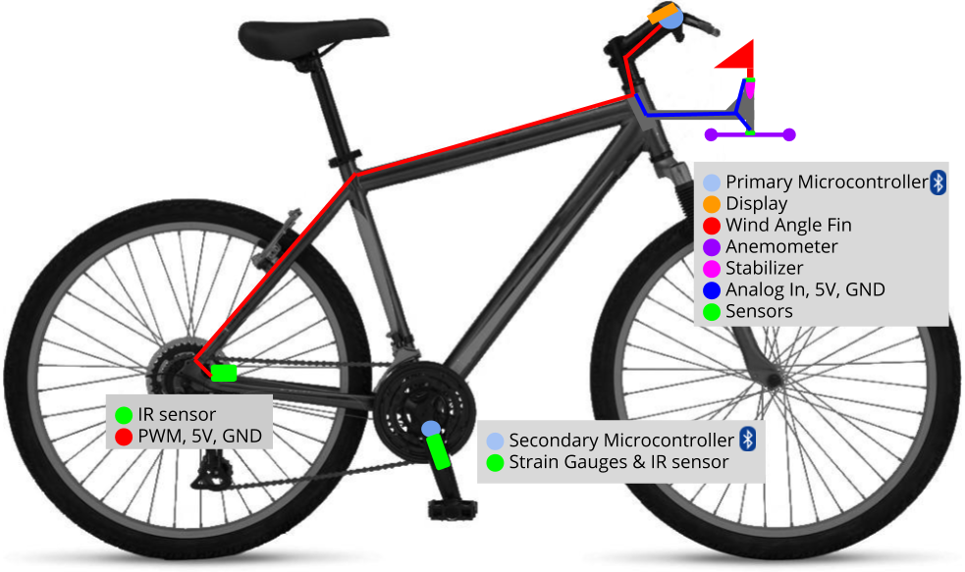
SKETCH
Notes:
The figure depicts a general layout of the components of the Cycle Statistic Tool. The primary microcontroller and display will be attached to the main frame of the bicycle within the line of sight of the user. The anemometer and wind angle fin will be mounted in an unrestricted location at the front of the cycle. The secondary microcontroller is mounted on the pedal shaft to inhibit any physical tethering between the pedals and the frame, which would interfere with pedaling.

Slide 5
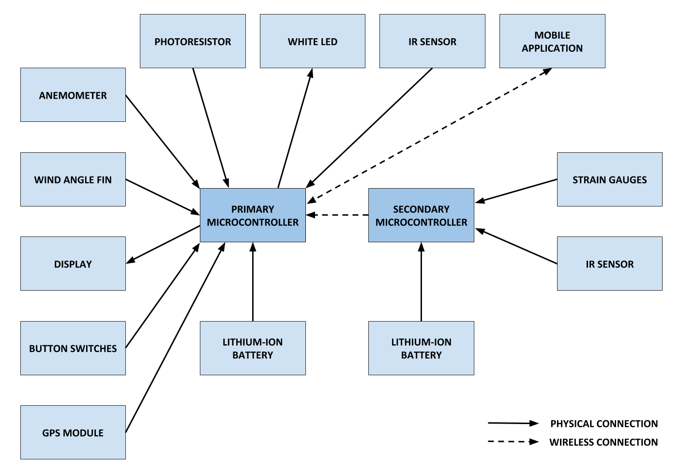
BLOCK DIAGRAM
Notes:
The block diagram of the cycle statistic tool represent the two microcontrollers used in our design and the system of components connected to each. The primary microcontroller will be used as the primary board to connect all sensors and for operation of the device. The secondary microcontroller will be attached to the pedal shaft to wirelessly relay data from this position to the primary board. The block diagram depicts each component connected to the respective microcontroller and the component’s method of transmission. The block diagram is a necessary prelude to the more detailed design schematics of the product.

Slide 6
BILL OF MATERIALS
Part Number | Product Name | Quantity | Cost per Unit | Description | Standards
ABX00027 | Arduino Nano 33 IOT | 2 | $18.40 | Microcontrollers with Bluetooth | IEEE 802.11b/g/n
Adafruit PID: 4224 | Adafruit eInk Breakout Friend with 32KB SRAM | 1 | $8.50 | Memory buffer for eInk display
Adafruit PID: 4262 | 2.9" Flexible Monochrome eInk | 1 | $26.95 | Low power eInk display
C000160 | Grove - Infrared Reflective Sensor V1.2 | 2 | $5.90 | Measures angular frequency
CEA-06-125UT-350 | Micro Measurements Strain Gages | 1 | $19.99 | Measures sheer force
176SF1D-L394 | Honeywell Precision Continuous 10K Potentiometer | 1 | $25.45 | Measures wind angle
PA1010D | Adafruit Mini GPS | 1 | $29.95 | 10Hz GPS module | GPS SPS PS
LP785060 | Lithium Ion Polymer Battery - 3.7v 2500mAh | 2 | $14.95 | Power for Microcontrollers
Notes:
The bill of materials for the final design are displayed. For each component purchased, we have listed the part number, product name, quantity, cost per unit, description, and any applicable standards. Some parts have still not been finalized, such as the stabilizer and motor for the anemometer. This is because we already have some parts that could be used for the project, first they need to be tested for efficacy.

Slide 7
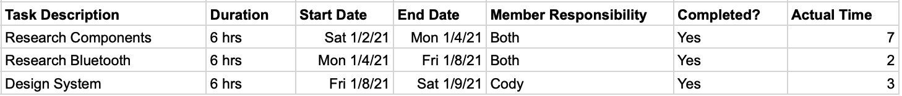
PROJECT PROGRESSION - COMPLETED TASKS
Notes:
The completed tasks for the Cycle Statistic Tool are shown. The expected and actual time for each task is displayed. Currently, these tasks consist of research and design of the product. We will continue to research components and bluetooth as the project continues.

Slide 8
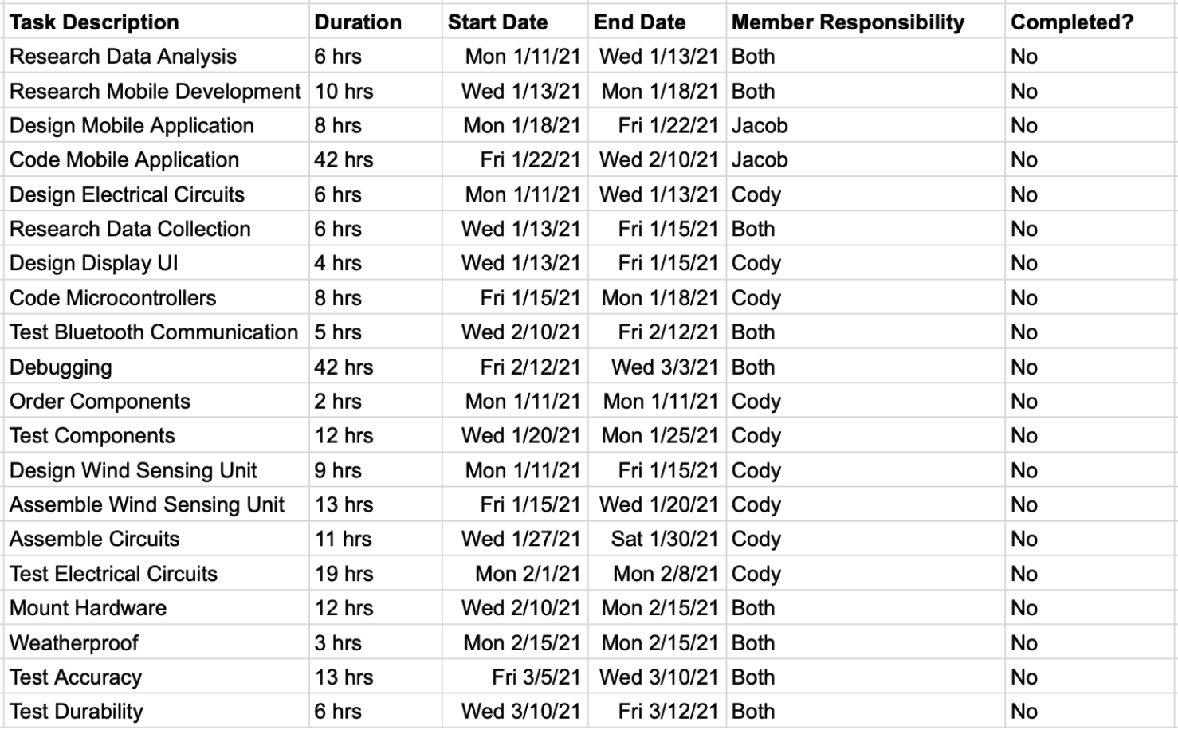
PROJECT PROGRESSION - UNCOMPLETED TASKS
Notes:
The uncompleted tasks for the project are shown. The list of tasks that are to be completed represent the task division that will be finished over the course of the next four months. The majority of these tasks consist of further research and development, ordering parts, building the Cycle Statistic Tool, Developing the companion application, and testing and debugging. I will now pass the presentation over to Cody to discuss the work breakdown structure, network diagram, and Gantt chart.

Slide 9
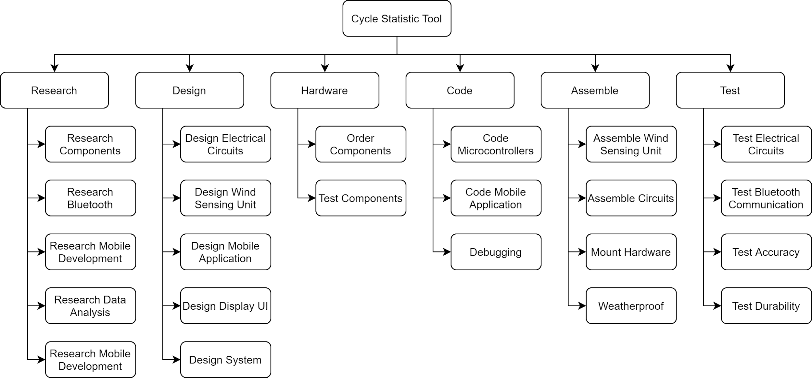
WORK BREAKDOWN STRUCTURE
Notes:
Here is our work breakdown structure. You can see each category of task and the tasks that compose them. This was used to break down everything that needs to be completed in order to create our time schedule.

Slide 10
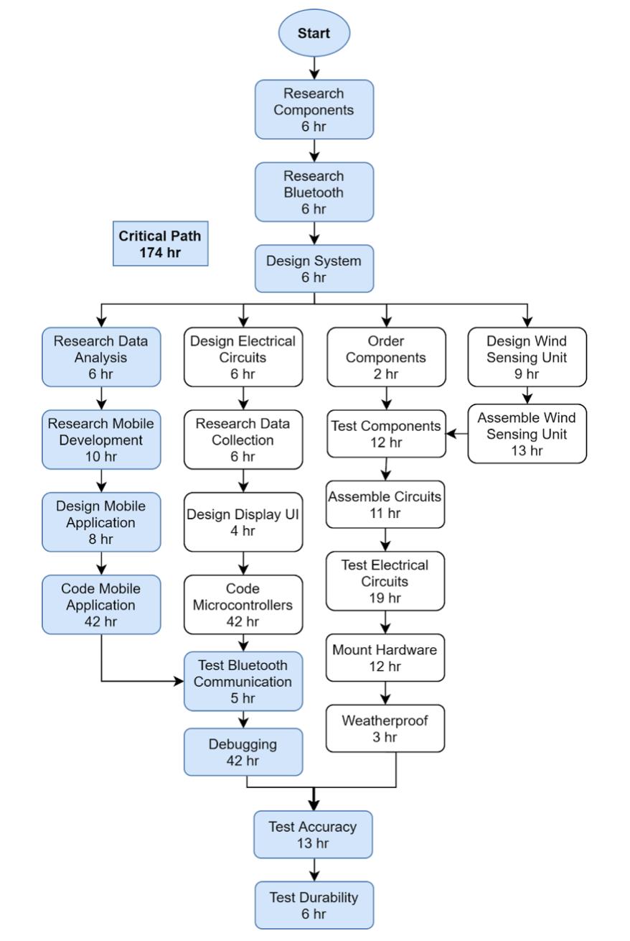
NETWORK DIAGRAM
Notes:
This network diagram shows the general order and flow of tasks as they are to be completed. This is helpful in identifying what can be done asynchronously and at what time. The path in blue is the critical path which is the path that will take the longest to be completed. The critical path is estimated to take 174 hours of work.

Slide 11
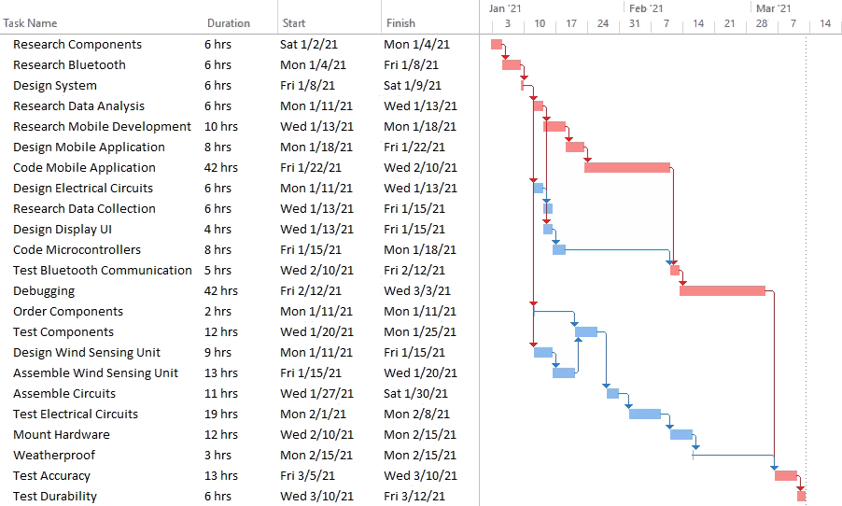
GANTT CHART
Notes:
This Gantt Chart was created from the network diagram that you saw from before. It is used to create timeline for when each task should be completed to stay on course with our deadline. In this chart the critical path is highlighted in red.

Slide 12
QUESTIONS?
Notes:
Now id like to open up our presentation for any questions the audience may have

